Slide 1
A computational simulation of neuromuscular block monitor sensitivity to procedural variability
Ryan Spears, Taylor Tew, Katie Carroll
12/12/17

Slide 2
Agenda
Background
Methods
Results
Conclusions

Slide 3
Agenda
Background
Methods
Results
Conclusions

Slide 4
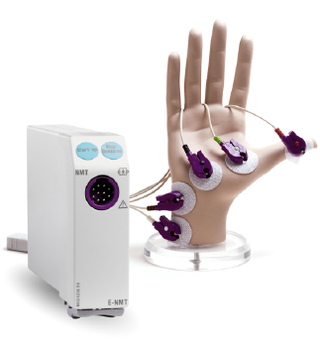
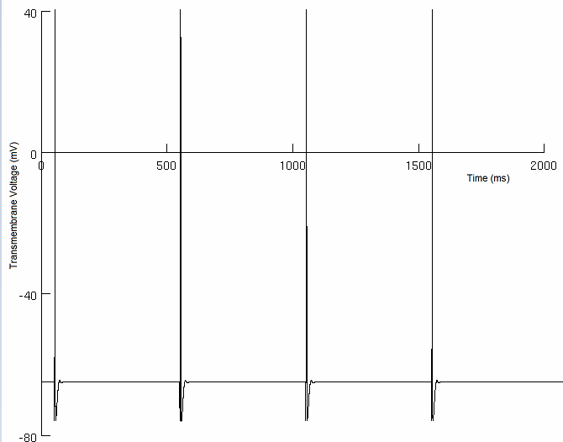

Neuromuscular Block Monitoring
Neuromuscular blocking agents (NMBAs)
Electromyography-based monitoring systems
Train-of-four (TOF) stimulation pattern: four 300𝜇s pulses at 2Hz
NeuroMuscular Transmission (NMT)

Slide 5
Clinical Observation
Increased subcutaneous fat thickness requires higher stimulation currents
Fat increases electrode-to-fiber distance
Fat insulates the fiber
Fat makes accurate electrode placement harder
Notes:
Investigative strategy:
Electrode-to-fiber distance
Fat thickness
Lateral electrode placement

Slide 6
Agenda
Background
Methods
Results
Conclusions

Slide 7
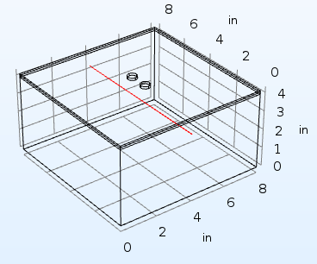
COMSOL Model
Skin-Fat-Muscle Interface
Geometry & Material Properties
Quasistatic Approximation
Boundary Conditions
Large Volume
Variability:
Fat Thickness (0.1in - 1in)
Electrode to Fiber Lateral Distance (0-1 in)
Current Stimulus (0 - 20 mA)
Nerve fiber positioned in 3D tissue COMSOL model with parameter variation
Notes:
Investigative strategy:
Electrode-to-fiber distance
Fat thickness
Lateral electrode placement

Slide 8
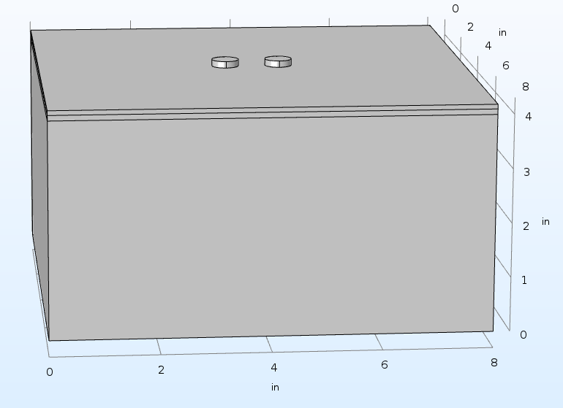
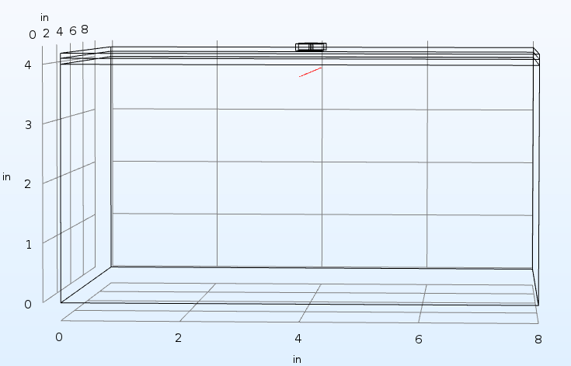
Lateral Electrode Position/Fat Thickness
Nerve Position held at constant Z-coordinate
Variation in Fat Thickness
Variation in Electrode-to-fiber lateral distance
Notes:
Investigative strategy:
Electrode-to-fiber distance
Fat thickness
Lateral electrode placement

Slide 9
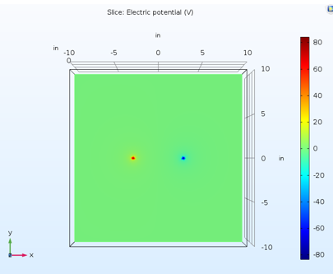

COMSOL Validation
Analytic Point Source vs. Experimental COMSOL Point Source Voltage in Homogeneous medium
$V(r)=\frac{I_{stim}}{4πrσ}$
Point (x,y,z) | COMSOL (V) | Analytical (V) | % Diff
-3, 1, 1 | 1.668 | 1.700 | 1.88%
-1, 0.5, -0.5 | 0.6928 | 0.6997 | 0.98%
0,0,0 | 5.022E-5 | 0 | 0%
-0.5, -0.5, -0.75 | 0.3054 | 0.2928 | 4.30%
4, 0, 0 | -2.6300 | -2.6854 | 2.06%
Point Source Voltage Distribution in COMSOL
Notes:
Investigative strategy:
Electrode-to-fiber distance
Fat thickness
Lateral electrode placement

Slide 10
NEURON & MATLAB
Interpolate voltages to internodal length
Simple single axon model:
Diameter: 20𝜇m
Length: 20.1cm (12.7cm from distal electrode)
Input voltages as nodal extracellular voltage sources
Action potential generation at terminal node interpreted as muscle activation

Slide 11
Agenda
Background
Methods
Results
Conclusions

Slide 12
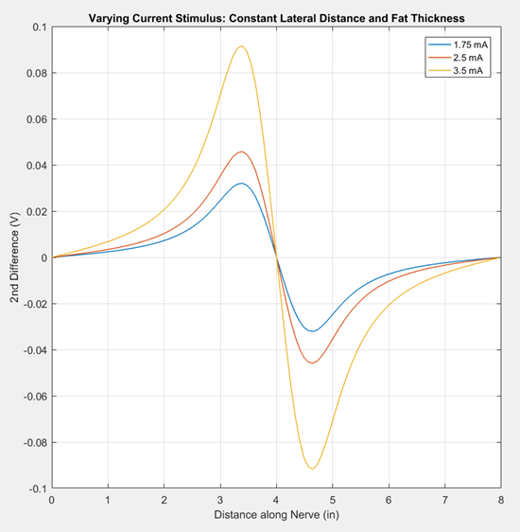
Current Stimulus
Lateral electrode distance and fat thickness held constant at 0.3 inches
Increasing current produced larger second differences
Second differences of extracellular voltage along the length of the axon for three current amplitudes.

Slide 13
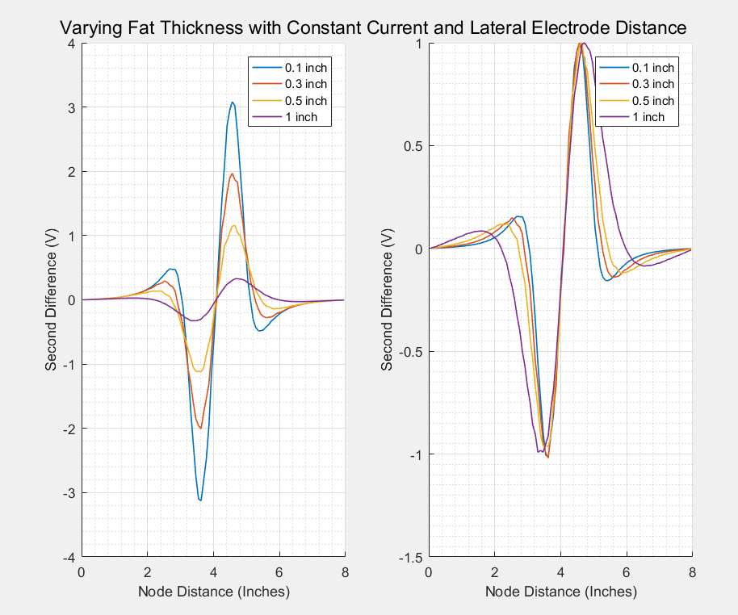
Fat Thickness
Lateral electrode distance held constant at 0.3 inches with a 5 mA current stimulus
Increasing fat produced smaller second differences
Second differences of extracellular voltage along the length of the axon for three lateral electrode positions.

Slide 14
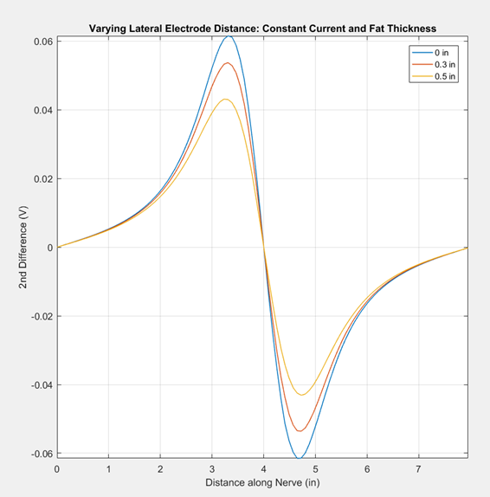
Lateral Electrode Distance
Fat thickness held constant at 0.3 inches with a 3.75 mA current stimulus
Increasing lateral distance from the electrode produced smaller second differences
Second differences of extracellular voltage along the length of the axon for three lateral electrode positions

Slide 15
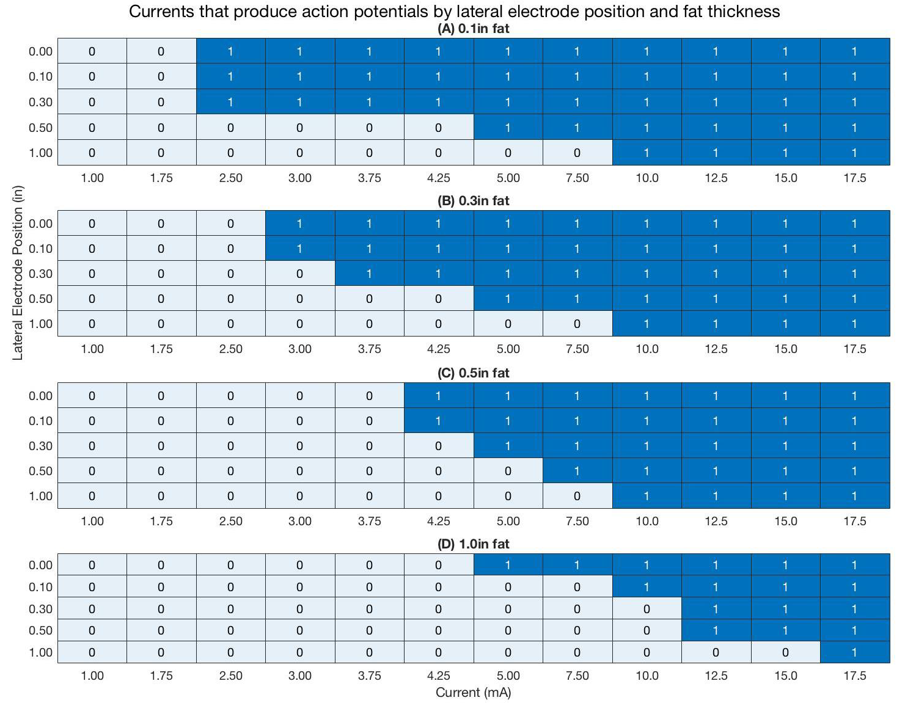
Summary
Increasing fat thickness and lateral electrode position have compounding effects on threshold current
Binary chart of action potential generation with parameter variation.
0: no action potential
1: action potential

Slide 16
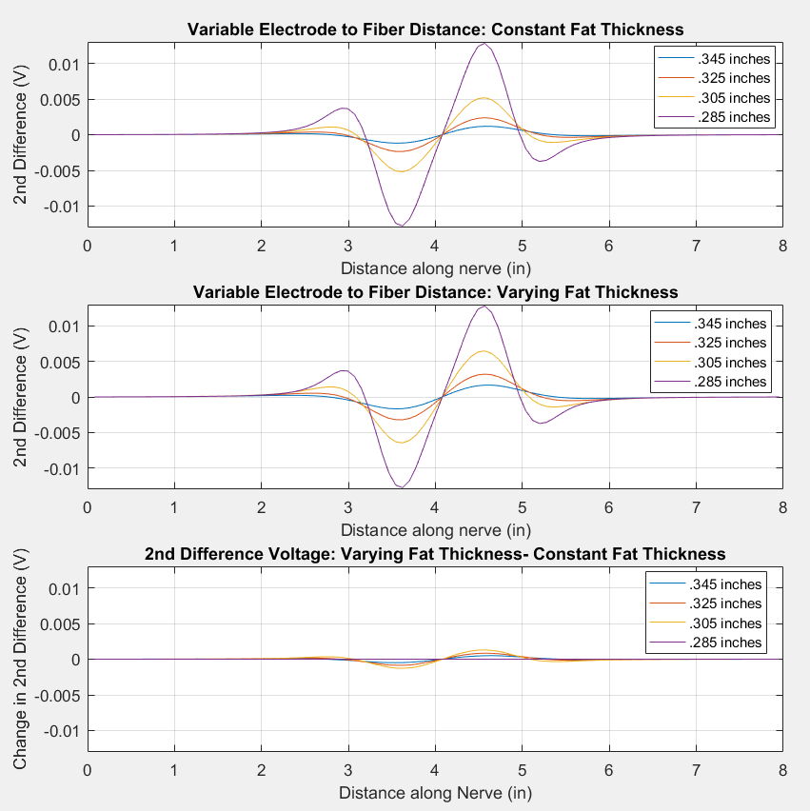
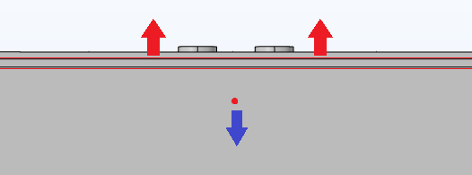

Isolating Fat Content Contributation
(top)
Δdepth = muscle
(middle)
Δdepth = fat
$$Ratio=\frac{V_{c, 0.285}−V_{c,n}}{V_{f,n}−V_{c,n}}$$
The contribution of fat thickness to second differences (bottom) was isolated by taking the difference of the second differences generated with constant fat thickness (top) and varied fat thickness (middle).

Slide 17
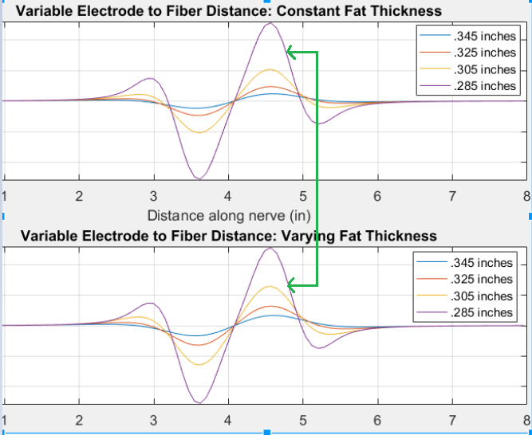

Isolating Fat Content Contributation
$$Ratio=\frac{V_{c, 0.285}−V_{c,n}}{V_{f,n}−V_{c,n}}$$

Slide 18
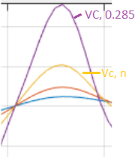
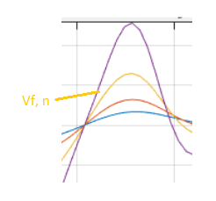

Numerator
$$Ratio=\frac{V_{c, 0.285}−V_{c,n}}{V_{f,n}−V_{c,n}}$$
Denominator

Slide 19
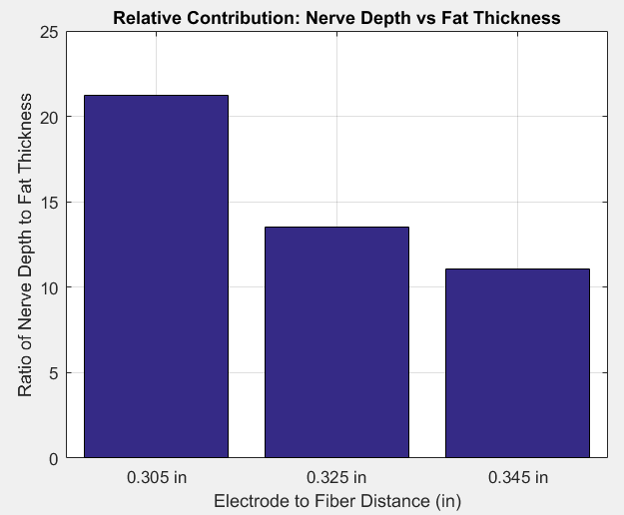
Isolating Fat Content Contributation
Electrode-to-fiber distance impacts second difference voltages more so than fat content
$$Ratio=\frac{V_{c, 0.285}−V_{c,n}}{V_{f,n}−V_{c,n}}$$
The relative contribution of electrode-to-fiber depth and fat thickness to second differences of extracellular voltage.
>1: predominance of electrode-to-fiber distance
<1: predominance of fat thickness

Slide 20
Agenda
Background
Methods
Results
Conclusions

Slide 21
Conclusions
Strength-Distance relationship predominates clinical observation
Electrode-to-Fiber Distance > Isolated Fat Content
Lateral Electrode Placement > Isolated Fat Content
Model/Study improvements:
COMSOL: nerve anatomy
NEURON: motor units/pools & graded output
Parallel clinical study

Slide 22
Questions?

Slide 23
Supplementary Material

Slide 24
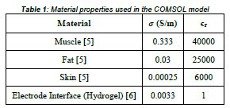
Supplementary Material: COMSOL
Volume Change Validation
Material Properties Table
 | X- Coordinate | Y- Coordinate | Z- Coordinate
Change in Voltage | -0.0082 | -0.0032 | -0.0117
% Diff | 0.4686% | 0.1825% | 0.6727%

